Slide 1
Drone Aided Recovery System
Trevor Yager

Slide 2
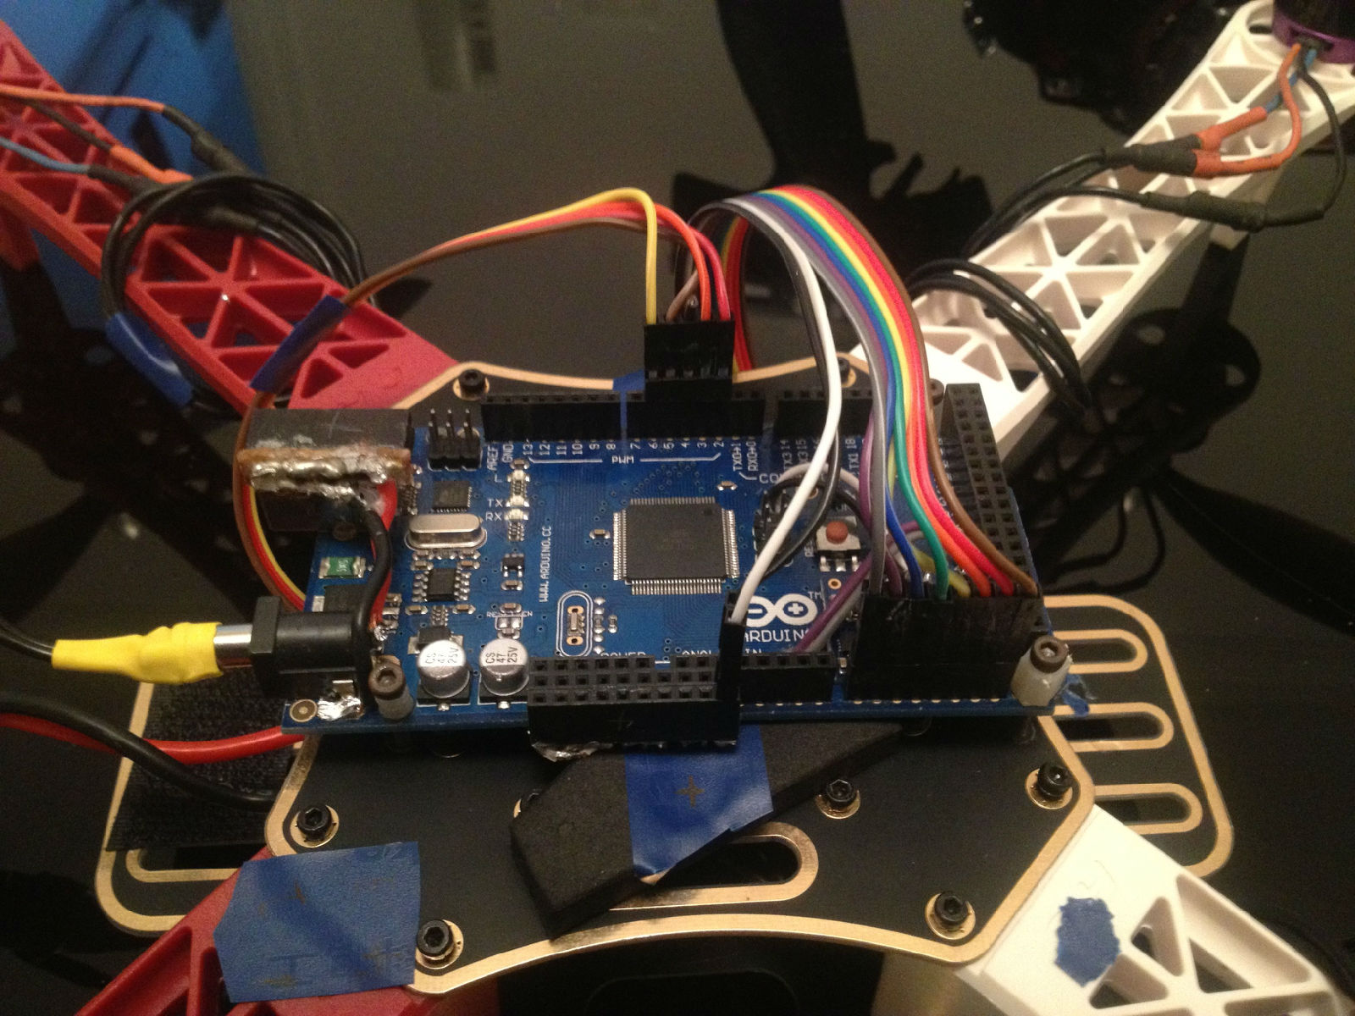
My Project
Create a quad copter that can aid in recover during natural disasters

Slide 3
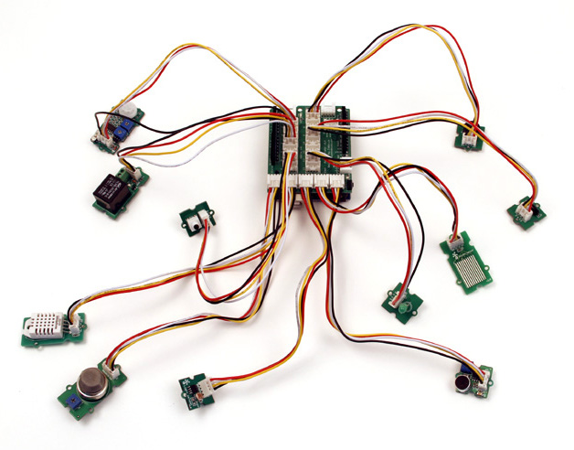
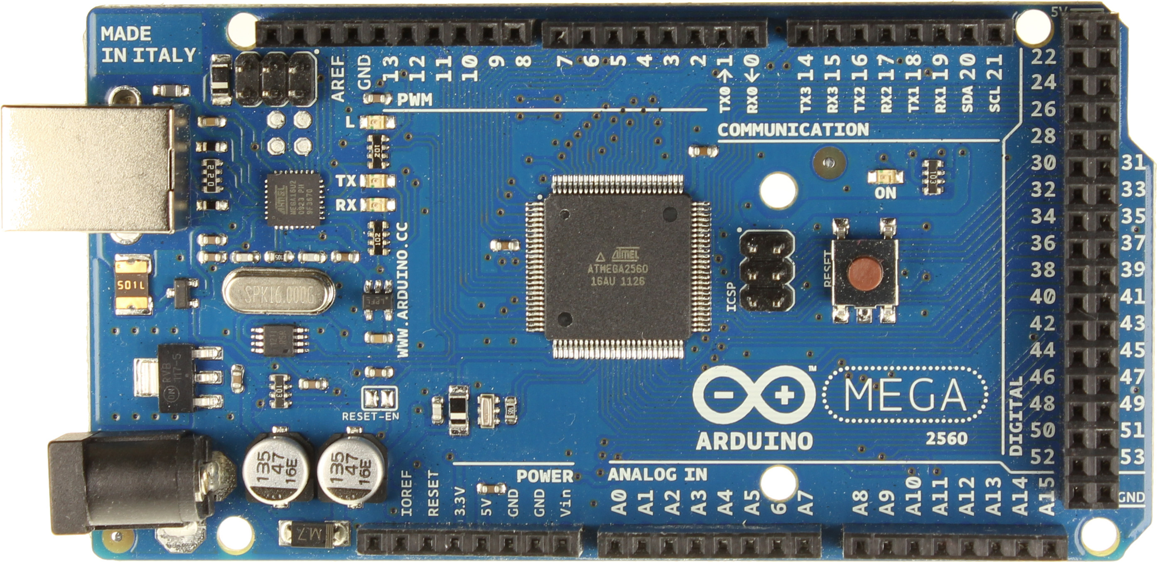
The Core
I will be using an Arduino board. This will be the “brains” behind the quad copter
Arduino is open source software that anyone can use
Based on C++

Slide 4
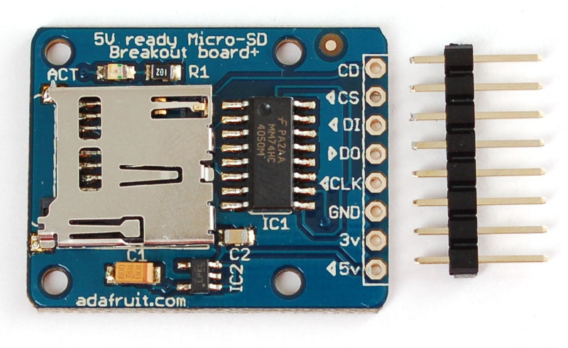
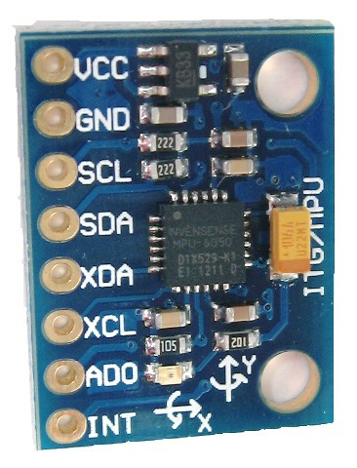
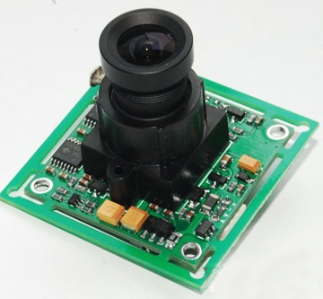
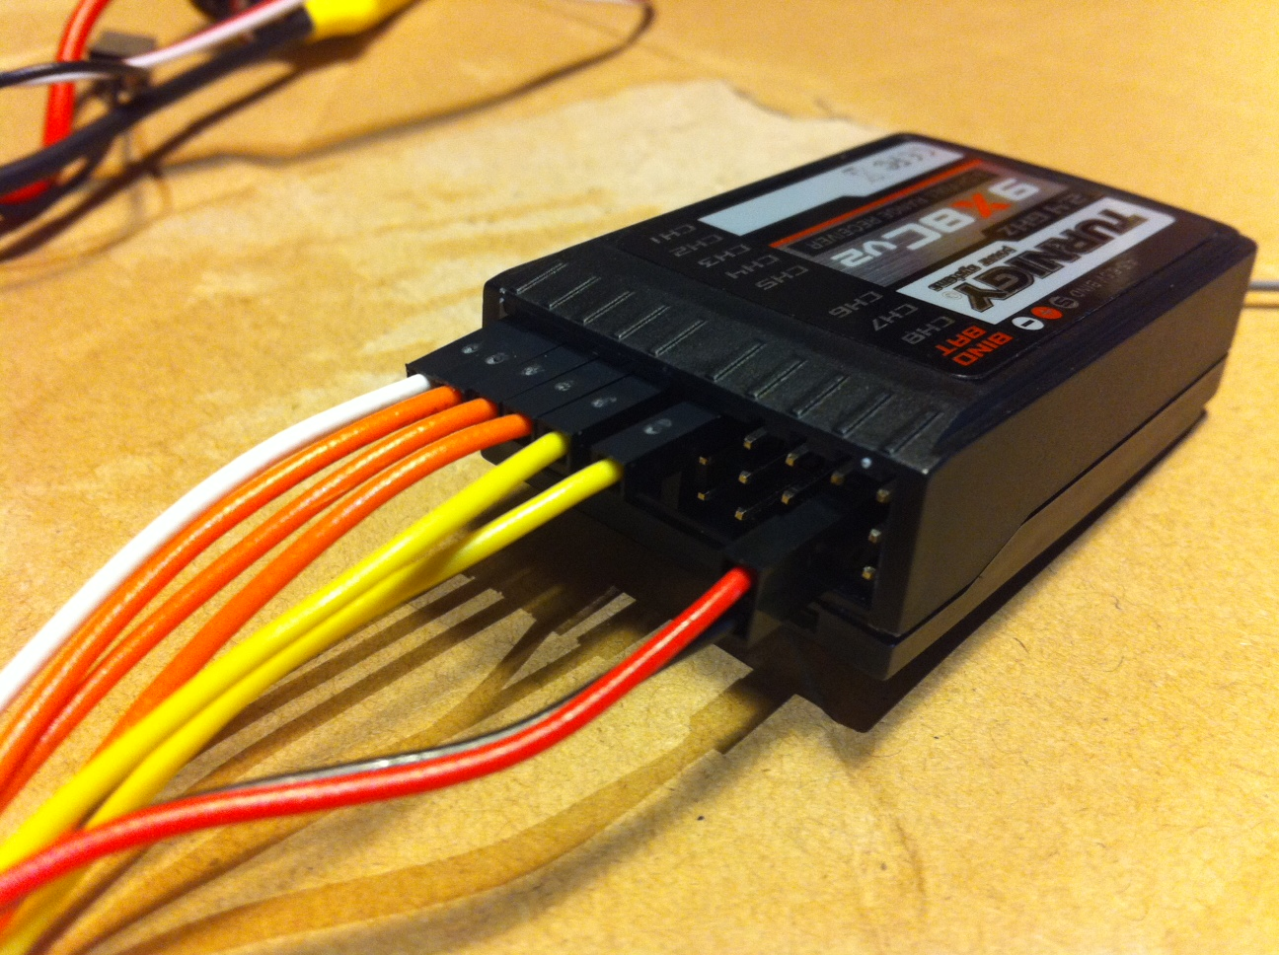
Add-ons

Slide 5
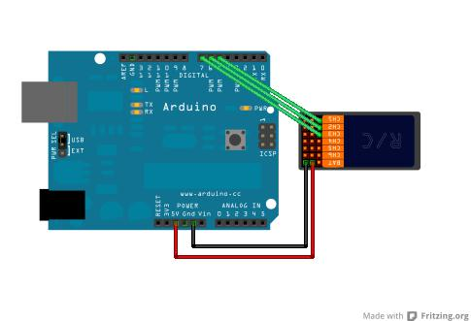
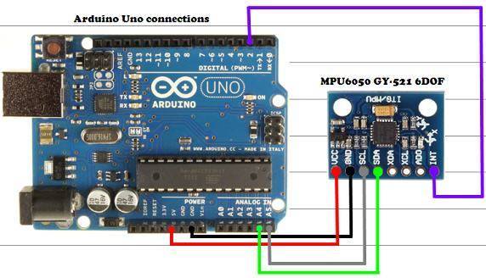
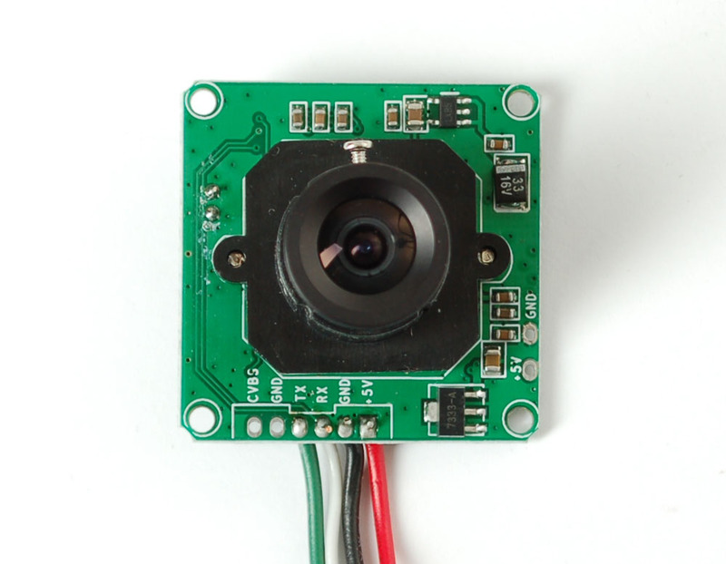
Interrupts
The backbone of my project is being able to handle in real time new signals being sent to the board

Slide 6

Calculations

Slide 7
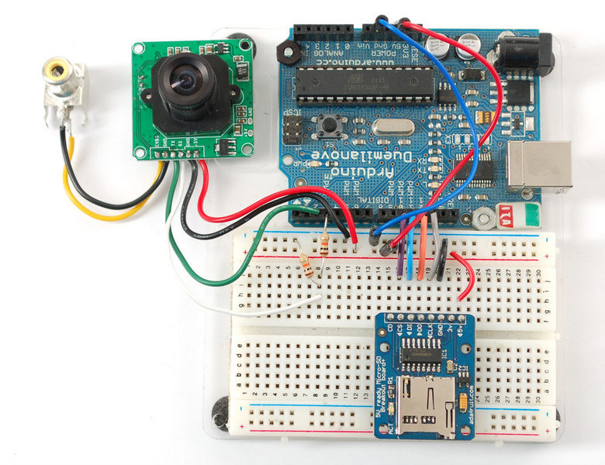
Imaging

Slide 8

Automatic Stabilization

Slide 9
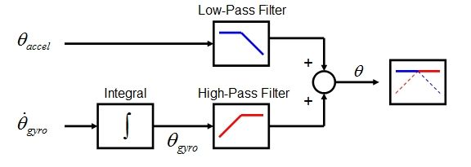
MPU-6050 and Complementary Filter

Slide 10
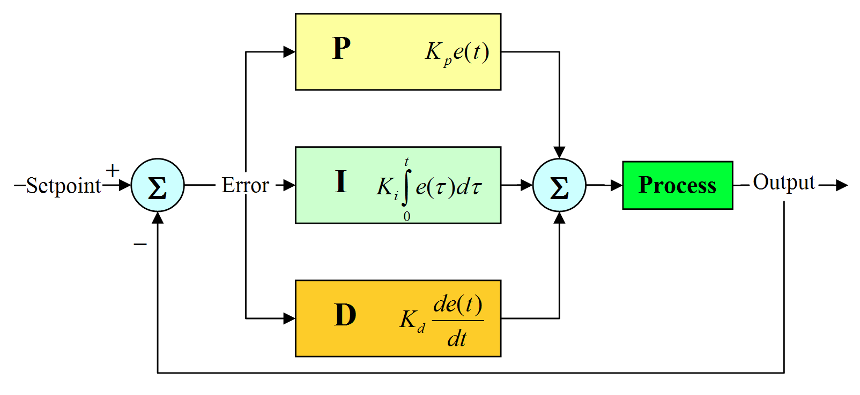
PID algorithm
Notes:
A proportional-integral-derivative controller (PID controller) is a control loop feedback mechanism (controller) widely used in industrial control systems. A PID controller calculates an error value as the difference between a measured process variable and a desired setpoint. The controller attempts to minimize the error by adjusting the process through use of a manipulated variable.

Slide 11
Issues and Blockers
Issues
Not powerful enough for streaming video
Conflicting libraries (PinChangeInt and SoftwareSerial)
MPU-6050 FIFO overflow
Blockers
Auto-stabilization
Notes:
Conflicting libraries
No video streaming
PID

Slide 12

Questions

